Slide 1
Chapter 9: Market Segmentation, Targeting and Positioning

Slide 2
Marketing Strategy Overview – Basic Structure
Analyze the environment and set the strategy
Company
(strengths & weaknesses)
Customers
Segment the market
Target your customers
Position your product
Competition
Product
Price
Promotion
Place
Leveraging real tools to implement strategic objectives

Slide 3
Preview
Market segmentation
Market-product grid to identify a target market
Sales forecasting
Product positioning

Slide 4
Market Segment
A group of customers
with common needs
who will respond similarly to market actions

Slide 5
Different Market Segments
Because of the existence of different market segments companies use product differentiation
Feature different product attributes, advertising to help consumers perceive the product as being different & better than competing products

Slide 6
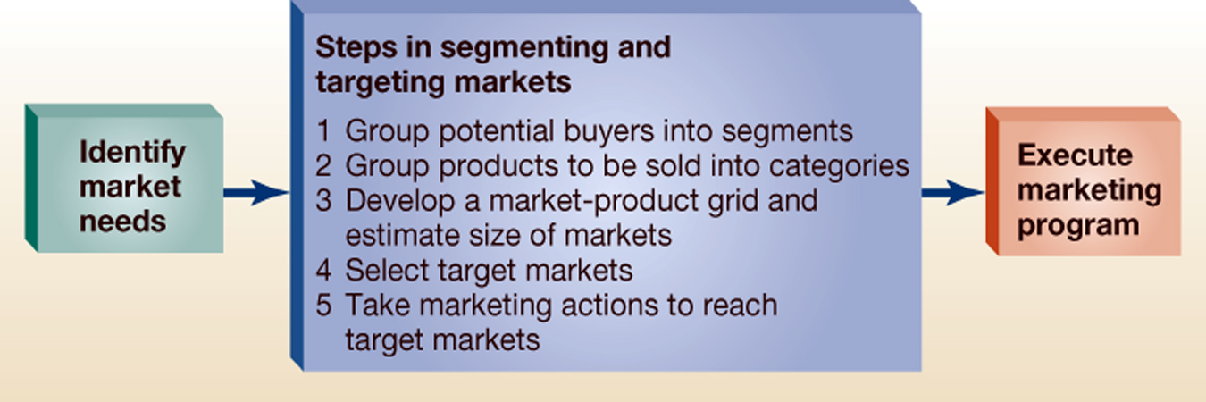
5 Key Steps
The five key steps in segmenting and targeting markets link market needs of customers to the organization’s marketing program

Slide 7
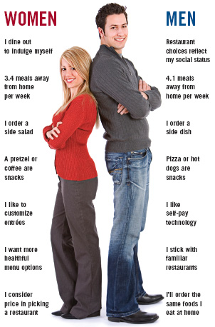
Two Familiar Segments

Slide 8

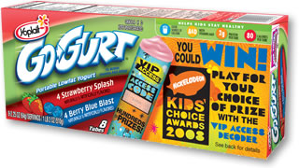
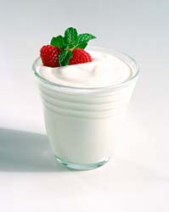
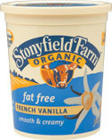


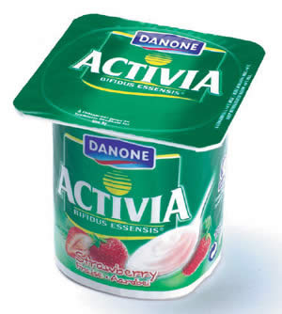

Yogurt

Slide 9
3 Situations for Marketing Segmentation
One product and multiple market segments
Multiple products and multiple market segments
Segments of one

Slide 10
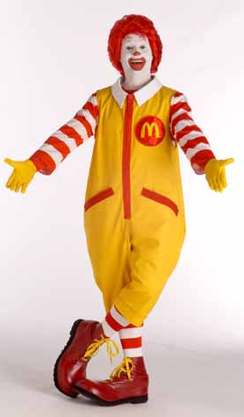

One Product, Multiple Segments
McDonald’s
VS.
Youth Targeted Commercial
Child Commercial

Slide 11




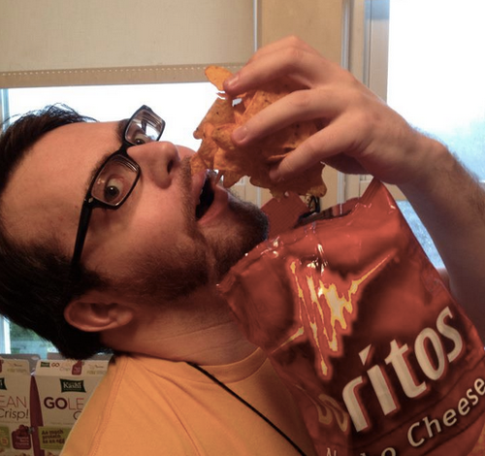

Multiple Products, Multiple Segments

Slide 12
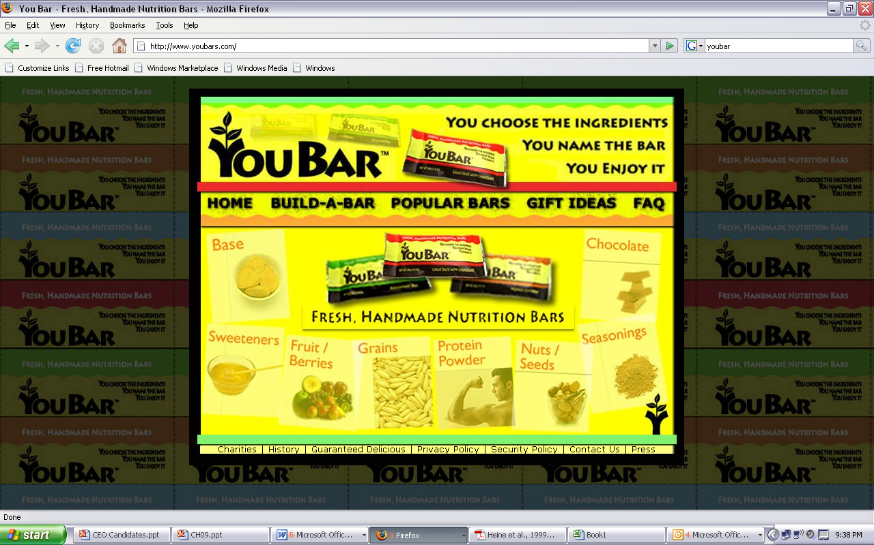
Segments of One: Mass Customization
YouBar

Slide 13
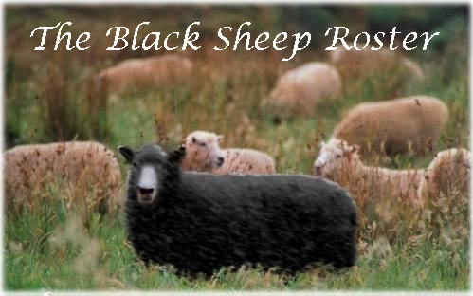
Step 1: Group Potential Buyers into Segments
Criteria to use in forming segments:
Similarity of needs of buyers within a segment
Difference of needs of buyers among segments
Potential of a marketing action to reach a segment
Potential for increased profit

Slide 14


Step 1: Group Potential Buyers into Segments
Ways to segment consumer markets
Customer characteristics
Geographic
Demographic
Psychographic
Buying situations
Benefits sought
patronage

Slide 15
Steps 2 & 3 in Segmenting and Targeting Markets
Step 1: Group potential buyers into segments
Step 2: Group products to be sold into categories
Step 3: Develop a market-product grid and estimate size of markets

Slide 16
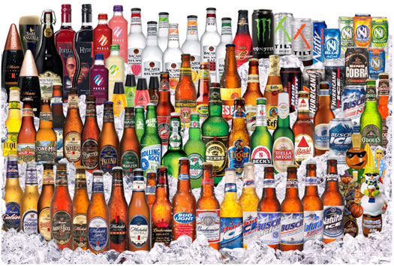
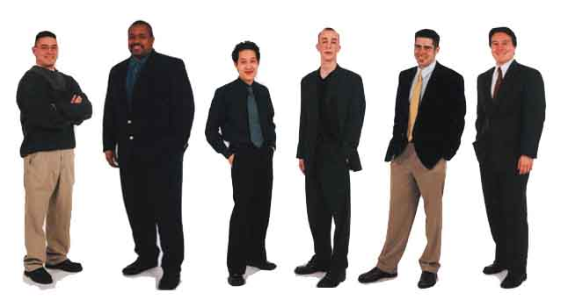
Market VS Product

Slide 17
Several Psychographic Segments
The beer industry commonly employs AIO (activities, interests and opinions) surveys to characterize changing life style patterns of beer drinkers.
Segments:
The Impulsive Drinker Segment.
Disagree with:
"I like to work on community projects."
"I have helped collect for the Red Cross."
"I find myself checking prices even for small items."
Agreed with:
"I am not very good at saving money,"

Slide 18
Macho Males
The "macho-male" segment
Agree with statements that reflect a 'very masculine view.'
"beer is a real man’s drink,"
"Playboy is one of my favorite magazines,"
"I am girl watcher,"
"men should not do the dishes,“
"men are smarter than women."
Outcome:
This Buds For You

Slide 19
Party Animals
The "party animal" segment.
Agree with:
"like to play poker,"
"like to take chances,“
"would much rather go to a party than spend a quiet evening at home."
Outcome:
Spuds

Slide 20
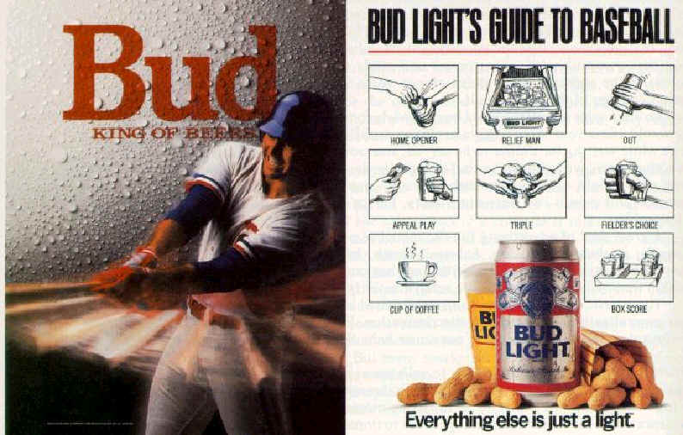
Sports and Physical Orientation
The "party animal" segment
Agree with
"I would like to be a pro football player,"
"I like bowling,"
"I would do better than average in a fist fight,“
"I prefer a good western on TV than a sitcom."
Outcome:

Slide 21
Step 4: Select Target Markets
Criteria to use in picking the target segments
Market size
Expected growth
Competitive position
Cost of reaching segment
Compatibility with the organization’s objectives and resources
Choose the segments

Slide 22


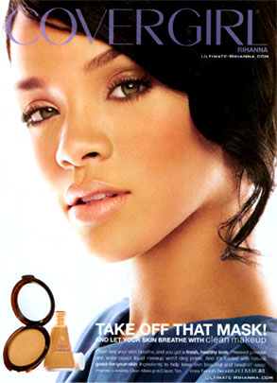
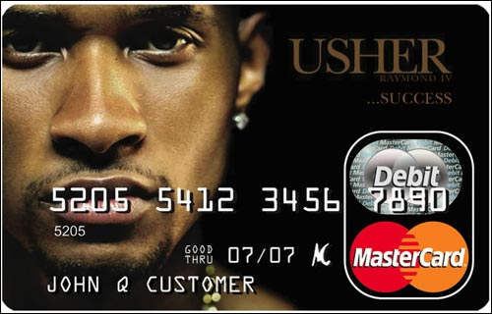
Positioning Using Celebrity Endorsement
One way to access a particular demographic with brand message →
Celebrity endorser

Slide 23
But Often Consumers Don’t Think Celebrities are Relatable or Relevant…
Jennifer Aniston
What did the article tell us about Celebrity Endorsers?

Slide 24

Step 5: Choose The Appropriate Segment
Position the product in a way that appeals to the chosen segment.

Slide 25
Positioning the Product
When the company launches the product it must decide how to position it in relation to other products
Product positioning
The place an offering occupies in consumers’ minds on important attributes relative to competing products

Slide 26
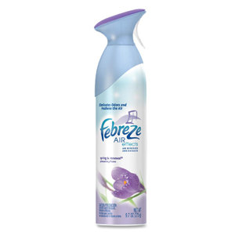
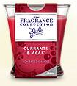
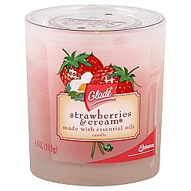
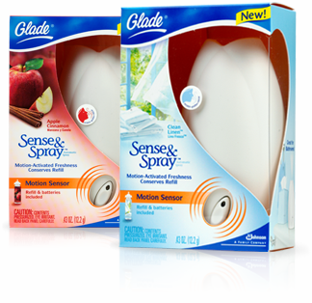
2 Positioning Approaches
Head to Head
Differentiation
Completing directly with competitors on similar product attributes
Seeking a less competitive or different market niche

Slide 27
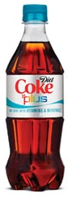
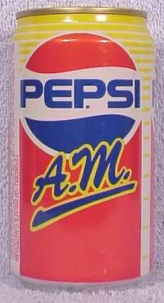
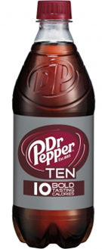
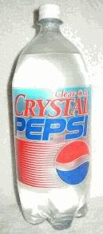
When Differentiating, Position with Important and Unique Attribute

Slide 28

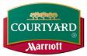


Perceptual Map
A means of displaying or graphing the “location” or the POSITION of a product in consumers’ minds
Mature
Budget
Expensive
Youthful

Slide 29
Activity
Get into groups and create a perceptual maps of several sporting equipment brands. First, choose two attributes that these will vary on and then plot each brand on the map.
Northface
Marmot
Patagonia
Moncler
Bogner
Canada Goose

Slide 30
Review
What are three kinds of marketing segmentation?
What are the five steps of market segmentation?
Positioning
Perceptual Map

